Slide 1
Dylan Wiliam (@dylanwiliam)
Embedding formative assessment
www.dylanwiliamcenter.com

Slide 2
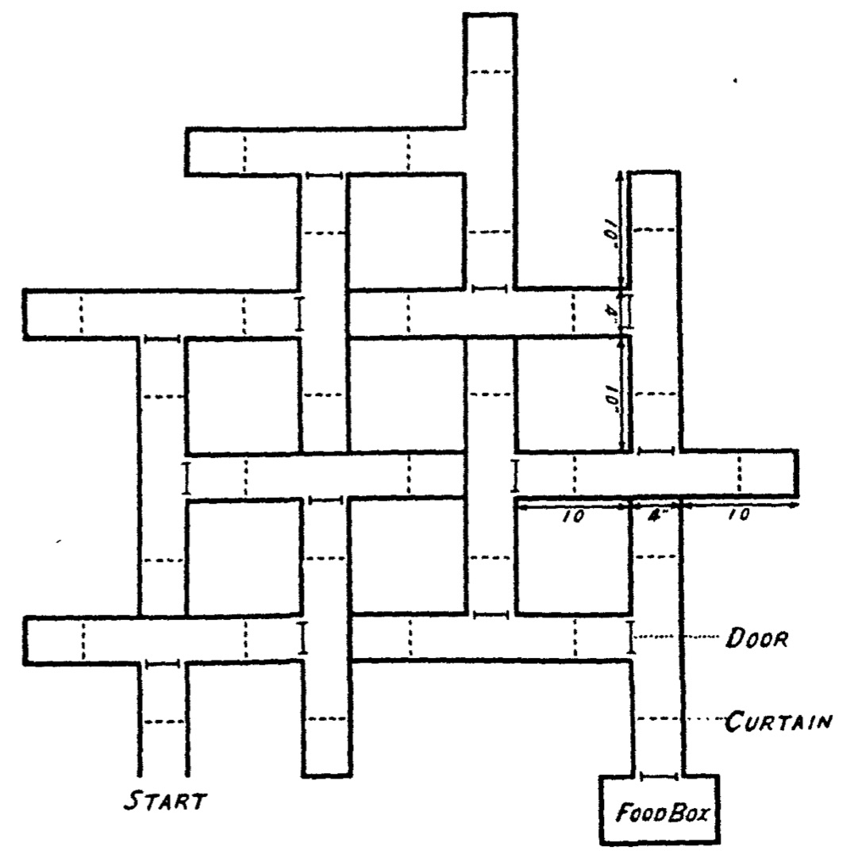
Learning and performance
Alley maze experiments
  Hungry rats put in mazes
  Removed when they reach the food box
  Learning measured by number of entrances into blind alleys

Slide 3
Learning and performance
Tolman and Honzik (1930) adapted by Sodestrom and Bjork (2015)

Slide 4
What is learning?
Learning is “a change in long-term memory”
(Kirschner, Sweller, & Clark, 2016 p. 77)
“The aim of all instruction is to alter long-term memory. If nothing has changed in long-term memory, nothing has been learned.” (ibid p. 77)

Slide 5
Where should our efforts be focused?
Which of these is most strongly associated with high student achievement?
  Student speaks the language of instruction at home
  Student behavior in the school is good
  The amount of inquiry-based instruction
  The amount of teacher-directed instruction
  The school’s socio-economic profile
Top 3 factors
  Student’s socio-economic profile
  Index of adaptive instruction
  The amount of teacher-directed instruction
OECD (2016, Fig II.7.2)

Slide 6
Why formative assessment needs to be a priority

Slide 7
Why Formative Assessment?
A principle and an uncomfortable fact about the world
  The principle:
    "If I had to reduce all of educational psychology to just one principle, I would say this: The most important single factor influencing learning is what the learner already knows. Ascertain this and teach him [or her] accordingly” (Ausubel, 1968 p. vi)
  The uncomfortable fact:
    Students do not learn what we teach.
  What is learning?
    Learning is a change in long-term memory (Kirschner et al., 2006)
    The fact that someone can do something now does not mean they will be able to do it in six weeks, but
    If they cannot do something now, it is highly unlikely they will be able to do it in six weeks

Slide 8
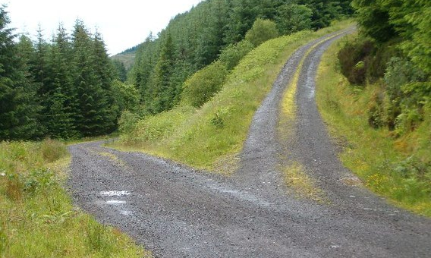
Building Plan “B” into Plan “A”

Slide 9
Relevant studies
Fuchs & Fuchs (1986)
Natriello (1987)
Crooks (1988)
Bangert-Drowns et al. (1991)
Dempster (1991, 1992)
Elshout-Mohr (1994)
Kluger & DeNisi (1996)
Black & Wiliam (1998)
Nyquist (2003)
Allal & Lopez (2005)
Köller (2005)
Brookhart (2007)
Wiliam (2007)
Hattie & Timperley (2007)
Shute (2008)
Kingston & Nash (2011, 2015)

Slide 10
Formative assessment: A contested term
Long-cycle
Medium-cycle
Short-cycle
Across terms, teaching units
Within and between teaching units
Within and between lessons
Span
Four weeks to
one year
One to four weeks
Minute-by-minute and day-by-day
Length
Monitoring, curriculum alignment
Student-involved assessment
Engagement, responsiveness
Impact

Slide 11
Unpacking formative assessment
 | Where the learner is going | Where the learner is now | How to get the learner there
Teacher
Peer
Student
Clarifying, sharing, and understanding learning intentions
Eliciting evidence of learning
Providing feedback that moves learners forward
Activating students as learning
resources for one another
Activating students as
owners of their own learning

Slide 12
Unpacking formative assessment
 | Where the learner is going | Where the learner is now | How to get the learner there
Teacher
Peer
Student
Using evidence of achievement to adapt what happens in classrooms to meet learner needs

Slide 13
Strategies and practical techniques for classroom formative assessment

Slide 14
Clarifying, sharing and understanding learning intentions

Slide 15
“The indispensable conditions for improvement are that the student comes to hold a concept of quality roughly similar to that held by the teacher, is able to monitor continuously the quality of what is being produced during the act of production itself, and has a repertoire of alternative moves or strategies from which to draw at any given point. In other words, students have to be able to judge the quality of what they are producing and be able to regulate what they are doing during the doing of it.” (Sadler, 1989 p. 121)

Slide 16
Memory on land and underwater
18 (5f, 13m) student members of a university diving club were tested on their recall of two- and three-syllable words from four 36-word lists taken from the Toronto Word Bank spoken to them twice.
Students learned, and were tested on, the words while underwater, and while on the shore, resulting in four conditions:
  DD (learn dry, recall dry)
  DW (learn dry, recall wet)
  WD (learn wet, recall dry)
  WW (learn wet, recall wet)

Slide 17
Memory and context
 |  | Recall environment
 |  | Dry | Wet
Learning environment | Dry | 13.5 | 8.6
 | Wet | 8.4
11.4
No significant main effects; interaction effect: F=22.0; df = 1, 12; p= <0.001
Godden and Baddeley (1975)

Slide 18
Alcohol and memory
32 adults (aged 22 to 43) asked to memorize a map and a 19-item set of instructions for a journey
Half did so sober and half at the legal limit for intoxication
The following day, half of them were tested sober and half at the legal limit for intoxication.
 | Number of items correct
 | Day 1 | Day 2
Day 1: sober; day 2: sober | 17 | 17
Day 1: sober; day 2: intoxicated | 17 | 11
Day 1: intoxicated; day 2: sober | 18 | 13
Day 1: intoxicated; day 2: intoxicated | 16
16
Lowe (1981)

Slide 19
Share learning intentions
Keep the context out of the learning intention
  Differentiate success criteria, not learning intentions
  Process versus product success criteria
  Generic, not specific criteria
Start with samples of work, rather than rubrics, to communicate quality
  Quality cannot always be reduced to words
  Ensure deep and surface features are not aligned
  Don’t abdicate responsibility for quality
Get students to generate their own tests

Slide 20
Question generation and learning
210 Introduction to Psychology students studied a 2,300 word text “The work of being a bee”
Students prepared for a test given two days later
  One control group (left to their own devices)
  Six treatment groups
Foos, Mora and Tkacz (1994)

Slide 21
Six treatment groups
 | Generated by
 | Student | Experimenter
Outline | Generate an outline | Given experimenter-generated outline
Questions | Generate study questions | Given experimenter-generated questions
Questions + answers | Generate student questions with correct answers | Given experimenter-generated questions and answers
 | Generated by
 | Student | Experimenter
Outline | Generate an outline | Given experimenter-generated outline
Questions | Generate study questions | Given experimenter-generated questions
 | Generated by
 | Student | Experimenter
Outline | Generate an outline | Given experimenter-generated outline
 | Generated by
 | Student | Experimenter

Slide 22
Question generation and learning
210 Introduction to Psychology students studied a 2,300 word text “The work of being a bee”
Students prepared for a test given two days later
  One control group (left to their own devices)
  Six treatment groups
Four types of student-generated questions
  essay/fill-in-the-blank/multiple-choice/true-false
30-item test (15 multiple-choice, 15 fill-in-the blank)
Items classified as “target”/“non-target”
Foos, Mora and Tkacz (1994)

Slide 23
Test scores

Slide 24
Possible confounds
Student-generated material may have focused on material tested with easier items
Experimenter-generated materials targeted more items, resulting in less time to study each item
Retention intervals may have been shorter for students preparing their own materials
All experimenter-generated study questions were essay questions, while some student-generated questions were not

Slide 25
Experiment 2
50 general psychology students from 2 US colleges
Studied same text as experiment 1 for 30 minutes
Half asked to generate study questions as they read
Half given study questions generated by others

Slide 26
Experiment 2 results
Foos, Mora, and Tkacz (1994)

Slide 27
Engineering effective discussions, activities, and classroom tasks that elicit evidence of learning

Slide 28
Eliciting evidence
Two good reasons to ask a question
  To cause thinking
  To collect evidence to inform instruction
No hands up (except to ask a question)
  Choose students at random
  No opting out
Avoiding questions altogether

Slide 29
Alternatives to questioning
Declarative statement
  Conservatives believe in privatisation
  But the Labour Party also believes in privatisation
Reflective re-statement
  Labour, Conservative and Liberal Democrats believe in X
  So you’re saying that all three major political parties believe in X
Statement of mind
  X and Y seem contradictory. I don’t see how you can believe in both
Statement of interest
  I’m interested in hearing a little more about X
Student referral
  Your views contradict the views of the last speaker
Teacher opinion
  That certainly has(n’t) been my experience

Slide 30
Alternatives to questions
Student questions
  speaker question
    Can you express your confusion in the form of a question?
  class question
    Does any one else have a question about what X has been saying?
  discussion question
    What kinds of questions should we be thinking about now
Signals
  phatics & fillers
  pass (to another speaker)
Silences
  deliberate
  non-deliberate
Dillon (1988)

Slide 31
Eliciting evidence
Two good reasons to ask a question
  To cause thinking
  To collect evidence to inform instruction
No hands up (except to ask a question)
  Choose students at random
  No opting out
Avoiding questions altogether
All-student response systems
  Decision-driven data collection
  Finger voting, dry erase boards, exit tickets
Two kinds of questions
  Discussion questions
  Diagnostic questions

Slide 32
Eliciting evidence:
Kinds of questions

Slide 33
Discussion questions: Science
Ice-cubes are added to a glass of water. What happens to the level of the water as the ice-cubes melt?
  The level of the water drops
  The level of the water stays the same
  The level of the water increases
  You need more information to be sure

Slide 34
Discussion questions: History
In which year did World War II begin?
  1919
  1938
  1939
  1940
  1941

Slide 35
Diagnostic questions: Psychology
Which of the following is the most important difference between the theories of Piaget and Vygotsky?
  Piaget places greater importance on the role of conservation in cognitive development
  Vygotsky places greater importance on the role of cultural artifacts in cognitive development.
  Vygotsky did not believe in distinct stages of cognitive development.
  Piaget was a social constructivist while Vygotsky placed greater emphasis on cultural-historical activity theory

Slide 36
Developing good questions
Start by identifying a “hinge-point” in a lesson plan—a point where you need to collect evidence from students in order to decide what to do next
Identify any relevant misconceptions
  by discussion with colleagues
  by asking the question as an “exit-pass”
Develop the question
Ask colleagues to look for possible false-positives
Trial the question with students, asking them to explain their choices

Slide 37
Cognitive rules
Responses
A
Correct
B
Incorrect
C
D
E

Slide 38
What makes a good hinge question?
Essential:
  In no case do incorrect and correct cognitive rules lead to the same response
Desirable (in order of priority):
  Different incorrect cognitive rules lead to different responses
  Different correct cognitive rules lead to different responses
Two approaches to question writing
  Distractor-driven multiple-choice questions
  Multiple correct solutions

Slide 39
Multiple correct responses
20 cm
What is the area of the semi-circle?
A. B. C. D. E.

Slide 40
Providing feedback that moves learners forward

Slide 41
Origins and antecedents
Feedback (Wiener, 1948)
  Developing range-finders for anti-aircraft guns
  Effective action requires a closed system within which
    Actions taken within the system are evaluated
    Evaluation of the actions leads to modification of future actions
  Two kinds of loops
    Positive (bad: leads to collapse or explosive growth)
    Negative (good: leads to stability)
  “Feedback is information about the gap between the actual level and the reference level of a system parameter which is used to alter the gap in some way” (Ramaprasad, 1983 p. 4)
Feedback and instructional correctives (Bloom)

Slide 42
Discussion
Are the differences between how the term feedback is used in engineering and education important?
How do you feel about the term
“feed-forward”?

Slide 43
Feedback in psychology
Feedback is “any of the numerous procedures that are used to tell a learner if an instructional response is right or wrong” (Kulhavy, 1977 p. 211)
Key debate: confirmation vs. correction
  … it is no surprise that scholars have worked overtime to fit the round peg of feedback into the square hole of reinforcement. Unfortunately, this stoic faith in feedback-as-reinforcement has all too often led researchers to overlook or disregard alternate explanations for their data. One does not have to look far for articles that devote themselves to explaining why their data failed to meet operant expectations rather than to trying to make sense out of what they found. (op cit. p. 213)

Slide 44
… an evolving concept (Brookhart, 2007)
Conceptualization
Source(s)
Information about the learning process…
… that teachers can use for instructional decisions…
…and students can use to improve performance…
…which motivates students
Scriven (1967)
Bloom, Hastings and Madaus (1971)
Sadler (1983; 1989)
Natriello (1987); Crooks (1988); Black and Wiliam (1998); Brookhart (1997)

Slide 45
Kinds of feedback (Nyquist, 2003)
Weaker feedback only
  Knowledge of results (KoR)
Feedback only
  KoR + clear goals or knowledge of correct results (KCR)
Weak formative assessment
  KCR+ explanation (KCR+e)
Moderate formative assessment
  (KCR+e) + specific actions for gap reduction
Strong formative assessment
  (KCR+e) + activity

Slide 46
Effects of formative assessment (HE)
Kind of feedback | Count | Effect
Weaker feedback only | 31 | 0.14
Feedback only | 48 | 0.36
Weaker formative assessment | 49 | 0.26
Moderate formative assessment | 41 | 0.39
Strong formative assessment | 16 | 0.56
Nyquist (2003)

Slide 47
Wise feedback: Study 1
44 7th grade students in 3 social studies classrooms
Students wrote an essay about a personal hero
Students received critical feedback plus a note
  Control: “I’m giving you these comments so that you’ll have feedback on your paper.”
  Treatment: “I’m giving you these comments because I have very high expectations and I know that you can reach them.”
Double-blind RCT design
Students given a week to resubmit
Yeager, Purdie-Vaughns, Garcia, Apfel, Brzustoski, Master, Hessert, Williams, & Cohen (2014)

Slide 48
Student revisions

Slide 49
Wise feedback: Study 2
Same as study 1, except
  Different students
  Students are required to resubmit essays

Slide 50
Impact on achievement

Slide 51
Trust in school

Slide 52
Wise feedback: Study 3
Focus on “attributional retraining”
76 students in an urban NYC high school
One 20-minute computer-delivered intervention
Double-blind RCT, allocation to 3 conditions
  wise feedback (student testimonials re wise feedback)
  placebo control (written placebo testimonials)
  null control (puzzles)
Outcome measure: average scores on 4 core subjects
  English
  history
  math
  science

Slide 53
Wise feedback examples
Teachers give critical feedback, sometimes a lot of it, to students that they believe in. It’s a hard lesson. But I’ve come to learn that criticism doesn’t mean my teacher sees me as dumb. It means they think their students can reach that high standard.
Sometimes people think that all the red ink on your paper happens for some other reason, like maybe the teacher is biased. But think of pro athletes or baseball teams that make it to the World Series. Just like in sports, you need that critical feedback to get excellent.
The teachers who give me feedback that corrects my mistakes are the ones who really care. They take you seriously, like a good coach does. You might not get good criticism like that all the time in school. But when you do get it, it’s like gold.

Slide 54
Impact on student achievement

