Slide 1
  1. What can you tell students who seek study advice?
  2. How can you model effective learning strategies in the classroom?
  3. How might you bring up student mastery in a difficult topic you teach?

Slide 2
Make it Stick at
Touro
Peter C. Brown
April 12, 2019

Slide 3


What leads to learning?
Henry L. Roediger III
Mark A. McDaniel
A team of 11 cognitive psychologists
at 6 universities, over 10 years.

Slide 4
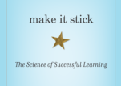
“People generally are going about learning in the wrong way.”
Part 1: 3 Big ideas about learning
          some of the underlying evidence
Part 2: Implications

Slide 5
3 Big Ideas about Learning
    Get it out to get it in.
    Some difficulties are desirable.
    Intuition steers us wrong.

Slide 6
3 Big Ideas about Learning
    Get it out to get it in.
    Some difficulties are desirable.
    Intuition steers us wrong.

Slide 7
Get it out to get it in
  Why?
        Retrieving a memory strengthens connections to what you know…
        and cues to recall it later.

Slide 8
Study vs. Retrieval
Task: Learn 50-word list over 8 trials
4 study, 4 retrieval
S R S R S R S R
S R S S S R S S
S S S S S S S S
6 study, 2 retrieval
8 study, 0 retrieval

Slide 9
More retrieval helped it stick
RECALL, 48 HOURS LATER
Recall probability
Number of Study Periods
More study was labor in vain
Recall probability
Zaromb & Roediger (M&C, 2010)
Number of Retrieval Attempts

Slide 10
Low-stakes Quizzes
Middle School
(Social Studies)
College
(Introductory Psychology)
% correct
% correct
Roediger et al. (2011)
Hodge, Thomas, & McDaniel

Slide 11
“Testing Effect”
(Retrieval)
Testing not only assesses what we know, but changes it:
  strengthens retention, and
  improves later performance
…more than additional studying.
Roediger & Butler (Trends in Cognitive Science, 2011)

Slide 12
3 Big Ideas about Learning
    Get it out to get it in.
    Some difficulties are desirable.

Slide 13
Desirable Difficulties
    Wrestling with new material so as to:
    Create understanding
    Embed learning in memory
    Create cues to recall it later
Notes:
Does not FEEL productive

Slide 14
For example:
Desirable difficulties
    Trying to figure it out, then getting corrective feedback.
    Elaborating to create meaning.
    (“Why?” “What if?” “How does it fit what I know?”).
    Spacing out learning & retrieval attempts.
    Mixing up practice of problem types.
Notes:
Does not FEEL productive

Slide 15
Spaced vs Massed Practice
Desirable difficulty
38 surgical residents learning microsurgery
Massed (19 docs) — 4 training sessions in 1day
Spaced (19 docs) — 1 session/week
over 4 weeks
(Moulton et al., 2006)

Slide 16
Test 1 month later
Demonstrate microsurgical
skills.
Surprise! Reattach severed aorta of anesthetized rat.

Slide 17
  Retention (microsurgical skills)
  Spaced learners: performed better on all expert measures
  Application
  Spaced learners: all completed surgery successfully
  Massed learners: 16% damaged tissue beyond repair
(Moulton et al., 2006)

Slide 18
Mixed vs Blocked Practice
Learn to compute the volume of a spheroid, cone, wedge, etc.
Desirable difficulty
During Practice
Test One Week Later
(Solve 8 types of solids in random order.)
89%
20%
Rohrer & Taylor (2010, Applied Cognitive Psychology)
Notes:
Students learn what procedure appropriate to calculate volume of each solid when practice interleaved. Will this same outcome hold for a more intense instructional setting like an course?

Slide 19
Mixed vs Blocked Practice
Learn to compute the volume of a spheroid, cone, wedge, etc.
Desirable difficulty
During Practice
Test One Week Later
(Solve 8 types of solids in random order.)
89%
20%
Rohrer & Taylor (2010)
Notes:
Students learn what procedure appropriate to calculate volume of each solid when practice interleaved. Will this same outcome hold for a more intense instructional setting like an course?

Slide 20
3 Big Ideas about Learning
    Get it out to get it in.
    Some difficulties are desirable.
    Intuition steers us wrong.

Slide 21
Judgments of Learning
Task: Learn key ideas in a 250-word prose
passage, over 4 trials
Pure Study: | S | S | S | S
1 Retrieval: | S | S | S | R
3 Retrievals: | S | R | R | R
“How well will you remember the passage in one week?”
Roediger & Karpicke (Psychological Science, 2006)
Notes:
reorder

Slide 22
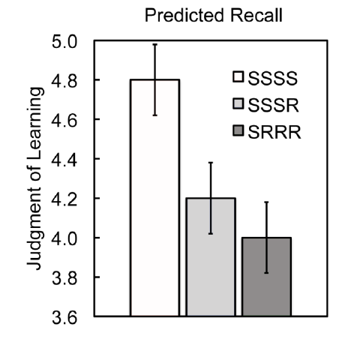
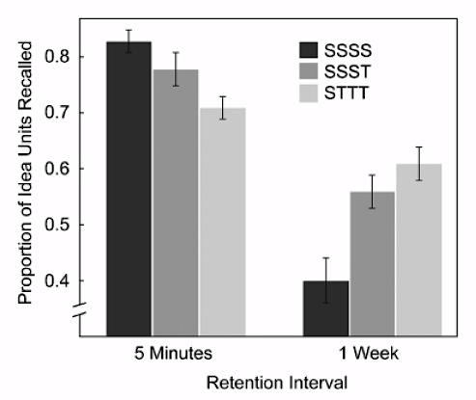
Task: Recall key ideas in a 250-word prose passage
Predicted Recall
Actual Recall
SSSS
SSST
STTT
Illusion of mastery

Slide 23
Surveys Asking Students
How They Study
Reread notes or textbook
Highlight material
Outline material
Study groups
Practice tests
84%
11%
Karpicke, Butler, & Roediger (Memory, 2009)

Slide 24
Lectures
Texts
Highlighting
Note-taking
Videos
All-nighters
Blocked & massed practice
…do not make it stick.

Slide 25
3 Big Ideas about Learning
    Get it out to get it in.
    Some difficulties are desirable.
    Intuition steers us wrong.

Slide 26
We know what strategies
are effective
…but they are
counter-intuitive.

Slide 27
“People generally are going about learning in the wrong way.”
Part 2: Implications

Slide 28
Students need to learn
content and strategies.

Slide 29
What do we do now?

Slide 30
Model effective strategies
Be transparent
Help students create understanding
Space instruction
Mix related problems in homework
Quiz often (reach back to carry forward)

Slide 31
Examples from the field

Slide 32
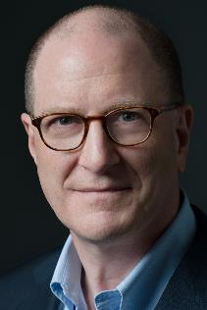
Andrew Sobel
Washington Univ. at St. Louis
    International political economics:
        Replaced 2 midterms and final exam w/ 9 quizzes over 26 week term
    Cumulative: “Reach back to carry forward”

Slide 33
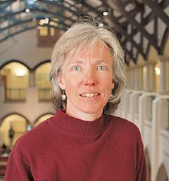
Mary Pat Wenderoth biology professor, U. of Washington
    Coaching
      How learning works
      Knowing v. illusion of knowing
      Habits of mind in the sciences
    2) Modeling

Slide 34
Replaced “low structure” with “high structure”
Wenderoth
Daily quizzes and weekly practice exams
Free-recall exercises
Summary sheets to elaborate & integrate
Write-to-learn exercises
Peer instruction

Slide 35
High-Structure Class
Wenderoth
Helps students:
Construct their own understanding
Elaborate on new knowledge
Favor retrieving over reviewing
Space and interleave practice
Recalibrate their judgment

Slide 36
Results:
Wenderoth
    (Intro Bio for majors)
    Washout rate cut from 18% to 6%
    Scores higher on Bloom’s

Slide 37
Mari Bergerson
Nova Classical Academy
:
Frequent low-stakes quizzing in every course.
 | 2015 | 2016
MATH
6th | 85.0% | 91.8%
7th | 75.6% | 87.7%
8th | 67.5% | 90.9%
READING
6th | 80.0% | 89.0%
7th | 75.6% | 89.0%
8th | 66.2% | 92.2%
2016 Minnesota Comprehensive Assessment Proficiency

Slide 38
Jay Dennis
AP economics, Pascagoula, MS
      Daily open-ended questions.
      Fridays: Free Response Question, drawn from prior AP exam.
      5 tests over 9 weeks.

Slide 39
Jay Dennis results:
College Board Exam
 | 2011 | 2013 | 2015
Classroom pass rate (%) | 33 | 30 | 60
Mississippi pass rate | 12 | 19 | 31
National pass rate | 62 | 66 | 66

Slide 40
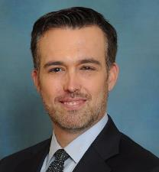
Louis Schulze
FIU College of Law
Miami
Applied “Make it Stick” throughout law school curriculum.

Slide 41
Schulze/FIU
Orientation & 1st Semester: explicit training
2nd Semester support for bottom 20%
Bar prep:
  80% practice exams vs. 4 weeks of lectures
  (“Your scores will be awful.”)

Slide 42
Schulze/FIU
FIU’s pass rate for bar exam:
#1 among FL law schools.
Formerly #4 or #5.

Slide 43
What do we do now?

Slide 44
“I have shifted the educational lens
that I look through
from teaching to learning.”
  - Jay Dennis, AP Economics,
  Pascagoula, Mississippi

Slide 45
3 Big Ideas about Learning
    Get it out to get it in.
    Some difficulties are desirable.
    Intuition steers us wrong.

Slide 46
Workshop

Slide 47
What are we already doing along these lines that could be extended into other areas?
What are 2-3 competencies where student success is not up to target? How can we use these strategies to bring it up?
Where are massed and blocked strategies the norm and could be changed to spaced and mixed?
Can Touro “first year” courses for students & faculty help increase awareness & use of these strategies?
How will I coach my students on successful study strategies?
How can I incorporate frequent low-stakes quizzing in all of my courses?

Slide 48
A lifetime of successful learning

