Slide 2
Power Down

Slide 3
Baseline Survey

Slide 5
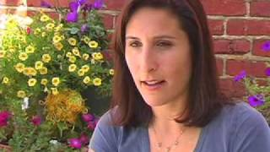
Quote
“Degrading someone is never right. It always comes down to what religion you are, socio economics, race or one’s sexual orientation or perceived sexual orientation” – Roslyn Wiseman, Author of Queen Bee’s and Wannabes

Slide 6
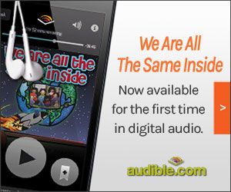
Professor Timothy Bellavia, M.F.A. email: timothy.bellavia@touro.edu Office phone: 646-795-4510 extension 47130 Academic Research Paper (s) http://gse.touro.edu/news--events/stories/prof-timothy-bellavia-beyond-skin-deep.php

Slide 7
What is a Sage doll?
US Patent 3 US20010046830 A1
http://www.naacpldf.org/brown-at-60-the-doll-test

Slide 8
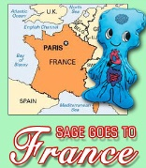
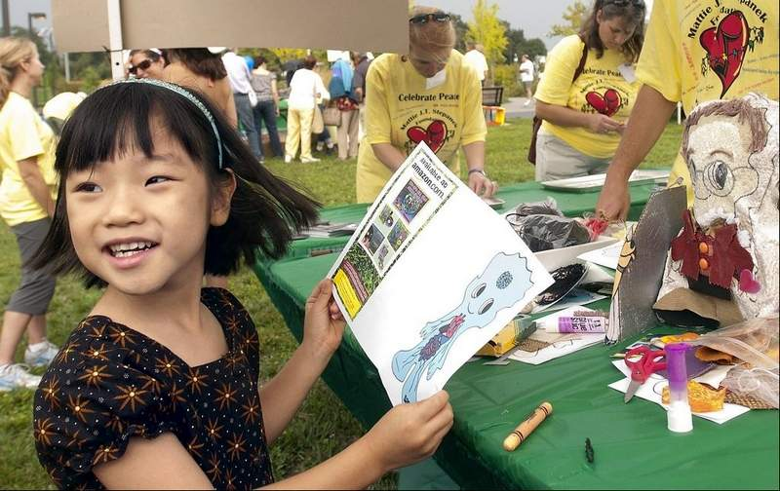
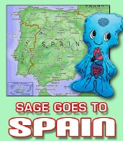
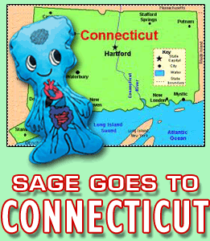
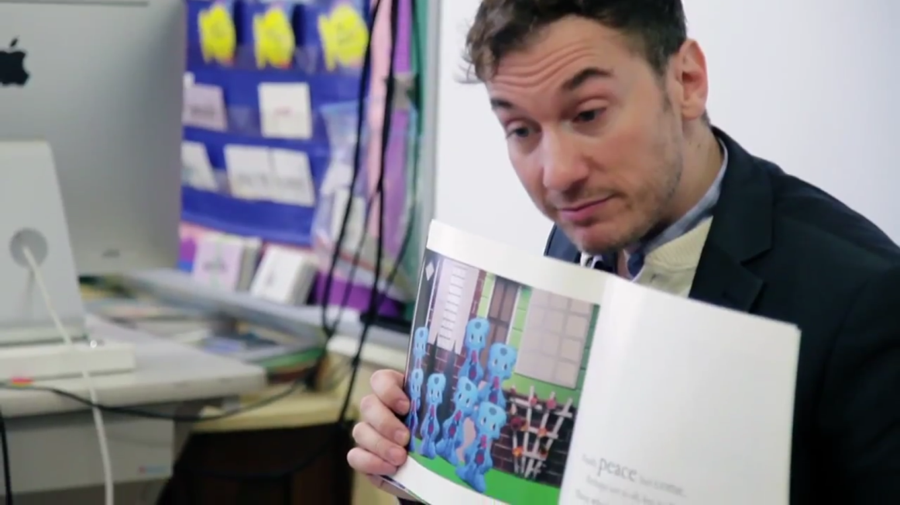
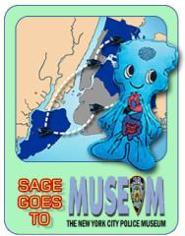
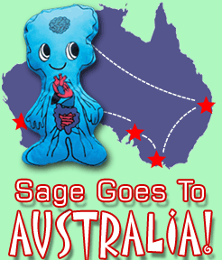
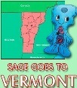
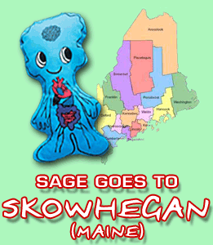
Read-a- Loud

Slide 9
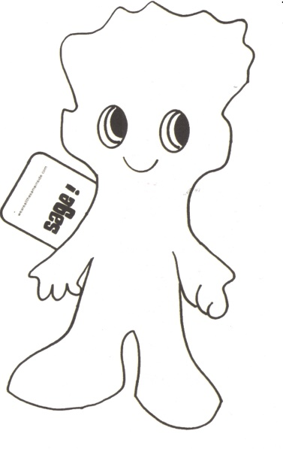
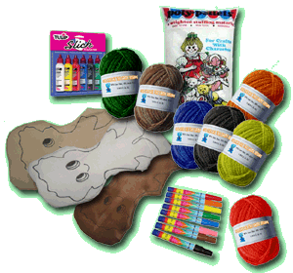
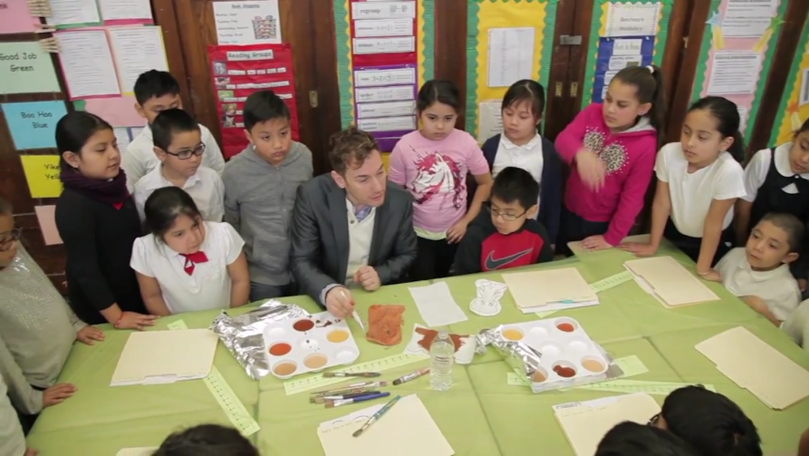
Workshop

Slide 10
Research

Slide 11
What is a Safe Space?

Slide 12
Beliefs Sage Cookie

Slide 13
Race / Ethnicity Sage Cookie

Slide 14
Socio-Economics Sage Cookie

Slide 15
Gender Sage Cookie

Slide 16
Extensions https://www.youtube.com/watch?v=LF1XOd8dKpE

Slide 17
Make it work!
14 Minute Sage ® doll-making

Slide 18
Questions

Slide 19
References
Carter, David (2004) Stonewall: The Riots that Sparked the Gay Revolution
Kohli,R & Solorzao, D. (2012)“ Teachers, please learn our name!: racial microaggression and the K-12 classroom.”Race,Ethnicity & Education. pp1-22.
My Learning Springboard-Liz Lasky, LCSW. Cyberbullying Retrieved from <mylearningspringboard.com/liz-lasky>
Nairn , K. & Smith,A. (2002). Educators Guide to Bullying Prevention
Nairn, K.& Smith, A. (September 2002). 'Bullying at school: Secondary students' experiences of bullying at school and their suggestions for dealing with it.' Youth Studies Australia. v.21, n.3, pp. 37-44.
National Institutes of Health, 2009 Survey on Bullying
New York Times, June 4, 2102, pp.A12-A13
Panel for Educational Policy
<http://schools.nyc.gov/AboutUs/leadership/PEP/publicnotice/2012-2013/July2013PEPRegulations>

Slide 20
2017 © All rights reserved. Photographs by TIMM-E Co, Inc. #weareallthesameinside #TimothyBellavia https://www.facebook.com/weareallthesameinside www.weareallthesameinside.org

